Slide 2


Investigation of pipeline failure
Mr Peter Airey
BE GradDipAdmin FIEAust CPEng RPEQ
Managing Director - Airey Taylor Consulting Engineers & Scientists
Chairman – Advanced Substructures Ltd

Slide 3
Burst HDPE pipeline
25 km long, large (650 to 800mm) diameter buried High Density Polyethylene (HDPE) irrigation pipeline, installed parallel to Gasgoyne River in Western Australia
The pipeline is a transmission main for collecting and conveying groundwater from a bore field to irrigation properties adjacent to the Gascoyne River
During final filling operations on December 19 2016, 800mm diameter section failed (burst)

Slide 4
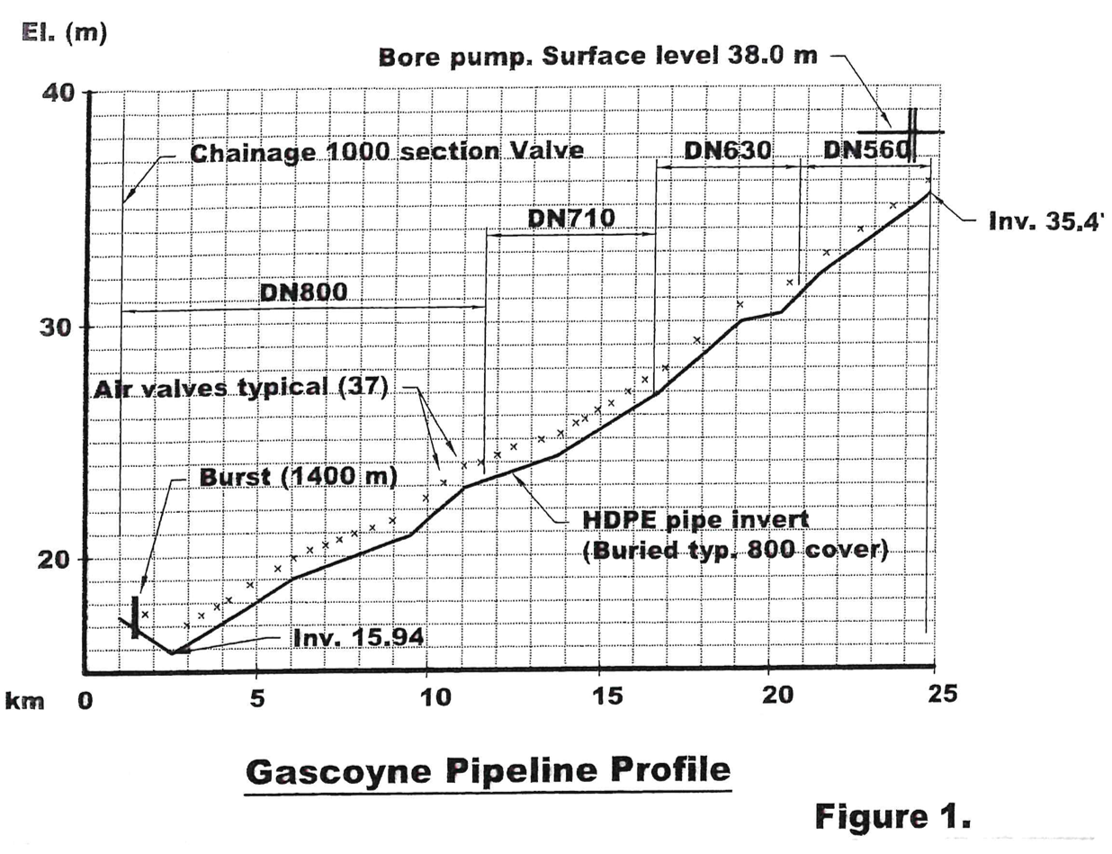
Pipeline profile
Designed for direct delivery of variable flow rates. The estimated maximum pressure at the lower (west) end was forecast to be 40 m. The test pressure was specified to be 60 m (600 kPa).
Sited in generally well drained sand (with about 15 % fines). Bedding and backfill was compacted excavated material. Minimum cover for the 800mm nominal diameter piping was specified to be 850 mm.

Slide 5
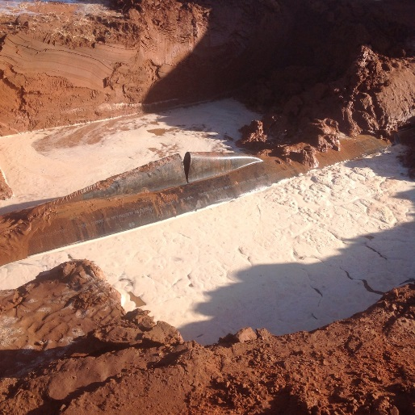
Pipeline failure
A length of 800mm nominal diameter PN6.3 pipe (inside diameter approx. 736 mm) yielded along the crown of the pipe and subsequently fractured during final flling operations. The failure was near the lowest point of the pipeline (invert approx. 16.5 m AHD).

Slide 6
Soils investigation
Backfilling and compaction procedures were initially thought to be responsible.
Detailed investigation of soil types and compaction techniques was conducted. It was concluded that “the rupture of the pipe was not related to the level of compaction in the trench.”
Consequently a separate investigation was conducted after the failed pipe length had been transported to Perth.
Following removal of the pipe and being transported to Perth, the failed section of pipeline is seen on the left.

Slide 7
Yield characteristics of HDPE
Inspection of failed pipe indicated pipe wall had yielded from average thickness of 31.8 mm to 5.2 mm – equivalent of 612%
Published test data indicates elongation prior to rupture usually 636%
Ground temperature estimate was 30 – 35°C, reducing capacity by 10% (from 630kPa to approximate 580 kPa)
Based on inspection and measurement, clear that pipeline had failed due to excessive internal pressure

Slide 8
Filling process
Pipeline volume 9.6 million litres; av. pumping rate of 25L/s; needs 106 hours to fill - was filled + checked over 10 day period, contractor : “a number of leaks identified and rectified”
Filled at bore pump near upper end (east) of the pipeline. Temp. connection between pump and pipeline had pressure gauge, visual flow meter + throttling valve – no means of limiting pressure or recording

Slide 9
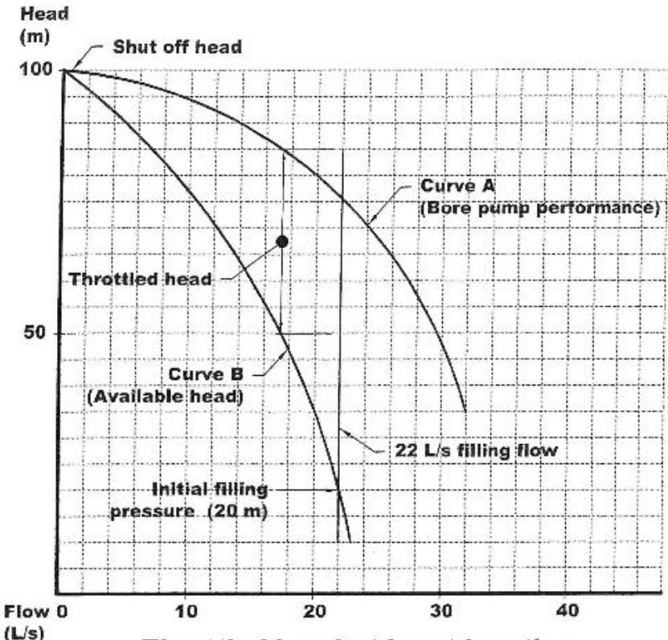
Throttled head at burst location
Curve A = Head capacity of the bore pump – as rated by manufacturer adjusted for bore drawdown and actual static lift
Curve B = available head that could be transferred after passing through throttling valve. On day of filling, pressure adjusted to initially limit inflow to 22 L/s. Applicable pressure gradually applied as pipeline pressurised. No record of pipeline pressure at time of failure exists.

Slide 10
Air Valves + Test Pressure
37 air valves successfully vented trapped air during filling – no air was observed venting on 19 December 2016. Review of ASCON drawings confirmed no location where measurable amount of air could be trapped.
Appropriate test pressure for HDPE (rated PN 6.3 or 630kPa) = 60m. Nominal rating includes a 2 to 1 safety factor based on ambient temperature of 20° – this safety factor judicious

Slide 11
Pressure Relief Valve (PRV)
PRV on completed pipeline on branch at chainage 1424, near lower (east) end of conduit – it was necessary to isolate PRV prior to pressure test
Following failure, PRV suggested to be adjusted to 450kPa under normal conditions
In addition to PRV, pipeline has 9 scour valves at low points – these were used to discharge dirty water during initial fill but were closed on 19 December 2016

Slide 12
Conclusions
All evidence suggests that the pipe was subject to a pressure higher than 500 kPa.
Failure occurred near the lowest point in pipeline under very low flow (almost static) conditions. Filling and pressurisation had located the most vulnerable situation.
It was suggested that the damaged section of pipe be replaced and that the pipeline be refilled and pressure tested at 450 kPa (at the lowest point of the conduit)

Slide 13
Conclusions
All air had been effectively displaced from the conduit and did not contribute to the failure.
HDPE material has similar yield characteristics to steel and actual fracture is preceded by gradual elongation.
Failure was not instantaneous but occurred over a time span of about 5 seconds, as the volume of the pipe increased due to increasing pressure.

Slide 14
Conclusions
The assumption of flexibility does not apply to large diameter HDPE pipe lines
Piping with SDR ratings greater than about SDR 15 are rigid - miscellaneous stresses can be locked into installed pipelines. For relatively thin wall pipes - curved alignments, bedding variations and other factors lock in non pressure induced stresses. South Australia Water Corporation, for instance, requires that PN 12.5 = SDR 13.6.
For large diameter HDPE pipelines, applicable in situ test pressure should include a safety factor of at least 2

